Slide 1

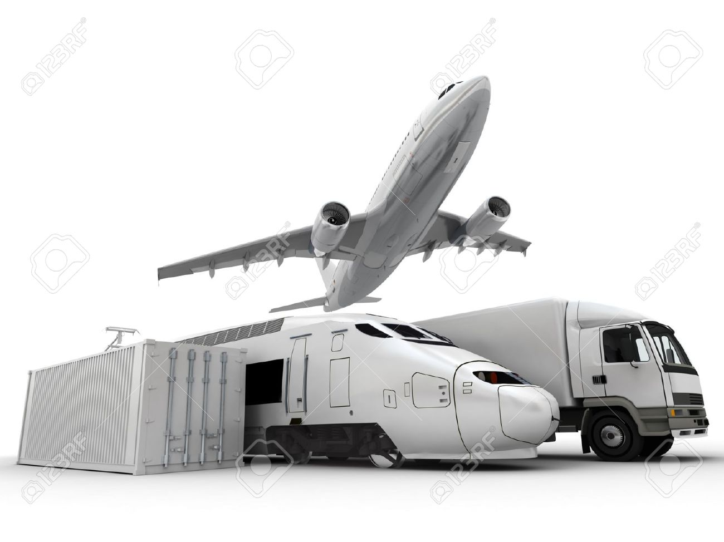
SRS LOGISTIC
“The Name Is Enough”

Slide 2


Our Vision & Mission:-
Vision:-
“We want to be the Largest Supply Chain solution provider”
Mission:-
“We want our customers , employees as well organisation more successful”

Slide 3

Our Product’s:-
Surface Mode (FTL& PTL)
By Train/Air
Ecommerce Delivery
Mobile Service Logistics
Reverse Logistics
Warehousing – Strategic location

Slide 4
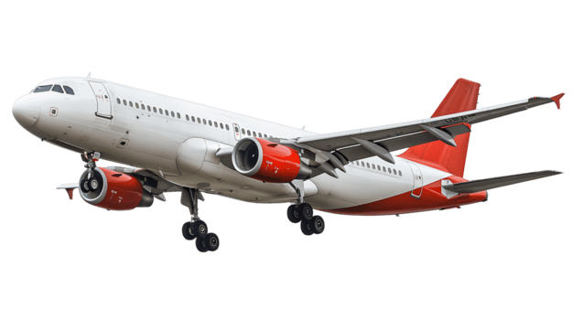
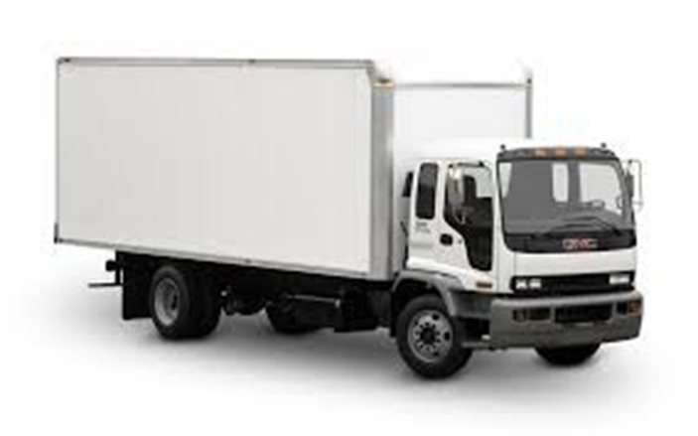
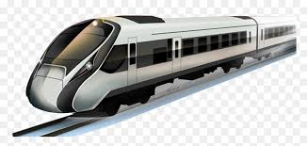
Surface/Train/Air
This product is for all such customer’s who desire in prompt connection & delivery of their Good’s\Media thru Surface/Train/Air/ Cargo Mode.
SRS Logistic is specialized in offering logistics solution for entire Pan India with fastest delivery/service network & Optimum cost

Slide 5

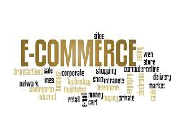
Ecommerce
This product is exclusively designed for ecommerce clients who want their shipments to be priorities & deliver’s to their customer’s with skilled people’s & handles properly
We also works on Reverse Logistcs\ Ecommerce shipments merchant pick-up’s\ B2C model
We returns & deposit your COD amount in next 24 hours of the delivery of your product, because we don’t want to earn a single profit from your COD Amount
We serve this product as per your requirement & convenience

Slide 6
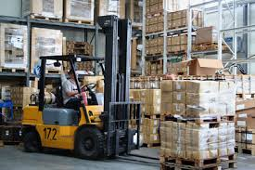
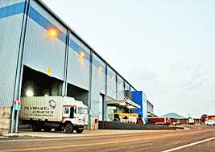
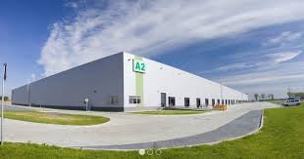
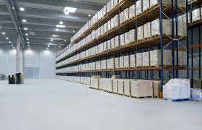

Warehouse Management
This product is exclusively designed for all those customers who just want their product’s ware housing has to be done by some reliable people’s
There are multiple kind of Ware House Management & options are available on different locations
We are always ready to understand your concern & provide you the complete B2B or B2C logistics solution

Slide 7

Why someone should choose SRSL?
We believe in customer first relationship
We understand Indian-Geography
We understand Logistics\Supply chain & Transportation that’s why running a Proprietorship Organisation
We know the importance of your business
We know the ecommerce demand & their future progress\growth in among entire Industry
We are the team of core Operations & Sales back ground with the sound knowledge of Finance
We works into Online Software designed specially for all products & requirement of the industry
All shipment\product can be track & trace upon our WEB
There will be regular MIS of your valuable shipments

Slide 8
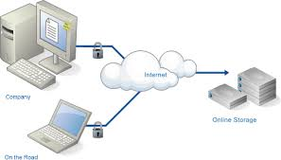


Our IT\Software
We have exclusively designed the best Online Software available in the market considering the current challenges & requirements
We believe in one click reports
All shipments tracking available upon WEB

Slide 9

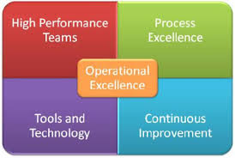


Our Operations & Customer Service Team
There are +10 years fully experienced leadership team engaged with us to serve you better & understand how to serve in different \difficult situations

Slide 10


Our Marketing & Sales Team
There are +15 years fully experienced leadership team engaged with us to understand the current Market scenario & developed the client relationship with us & full fill your requirement

Slide 11











Our Valued Customer’s:-
One Logistics All Solution.

Slide 12







Countinued…..

Slide 13
Our Network & Other:-
ALL KARNATAKA
ALL TELANGANA
ALL TAMIL NADU
ALL MAHARASHTRA
ALL EAST INDIA
ALL WEST BENGAL
ALL UTTAR PRADESH
ALL BIHAR
PAN INDIA SERVICE ALSO AVAILABLE
Door to Door Pickup and Delivery Service
Our WEB:- www.srslogistic.co.in
Our Customer Care Number:-
Ph. No. 0161-5251112
Cell No. 8591925541,9646363737
Email @:- info@srslogistic.co.in brijesh89123@gmail.com

Slide 14


